Slide 1
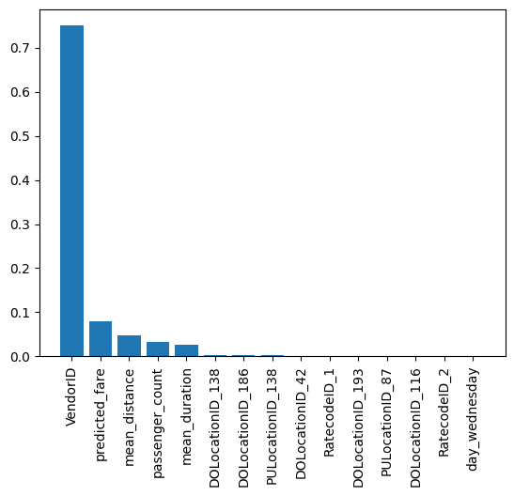
New York City TLC Project . Machine learning model. Tips level predictions
Execurive summary report
New York City Taxi and Limousine Commission (TLC) additionally requested to build a machine learning model that predicts if customer will leave tips after the ride.
Considering ethical of the original request and itsnegative impact on the business process, Data Team bran the alternative goal for new model, which would determine if the customer will leave the generous tips (>20%) or not.
With this goal two models were created (Random Forest and XGBoost models) and comparing with each other, choosing the best of them as a final model
The F1 score (harmonic metric) was chosen as a score comparison for the best model choise.
All nessesary modification of the data were provided and new additional features were created in order to increase model performance
Both models show similar score on test data.
Random forest was chosen as a final model, as it has better result on the test data
Although the f1 score for both models is around 73% the whole performance for both models is not very impressive
The most importante feature is VendorID, which suggest that belonging to particular vendor leads to mode generous tips or data reliability is differ from vendor to vendor. It is worth to investigate this moment
We do not suggest to use the current model, as its score is not acceptable.

